Slide 1
Thinking Poker Through Game Theory:
Does Aggression Pay Off in Heads Up Texas Poker
Group 1: Jeanpiere Soloranzo, Wenda Qin, Robert Xu

Slide 2
Poker and Game Theory
Poker can be seen as a game involving randomness and luck… but
Poker is a complex game to analyze, as there are many possibilities that can change through the course of the game
Various versions of poker in game theory use simplified variations of the game.
Models
2-Person Non-Zero Sum Game. or N-Person Game.
Game and loss are not equal. Outcome is not obvious
Use Mixed Strategy
Each player use a combination of strategies. Makes the other guess as to what they will do next.
Varies depending on player’s playstyle

Slide 3
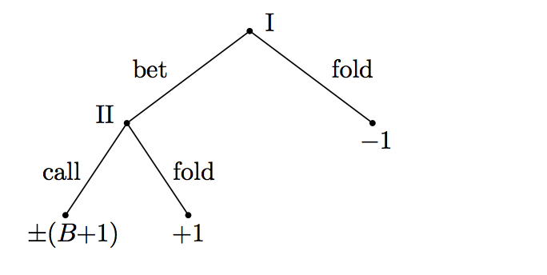
2 Classic Poker Models
Borel’s (1938) & von Neumann (1944) Poker Models
Player I is dealt a random hand X ∈ [0, 1] where X has a uniform distribution over the interval [0, 1];
Similarly, Player II receives a random hand, Y , according to a uniform distribution on [0, 1]. X != Y
Both players know the value of their own hand, but not that of the opponent.
Each player antes one unit. PI decides whether to bet or not. If P1 bets, then P2 decides whether to call or to fold.
If P2 folds, PI wins one unit (the ante) from P2.
If P2 calls, the hands are compared and the player with the higher hand wins an amount B + 1 from the 1 opponent, where B > 0 represents the amount of the bet.
Tree Diagram of Borel’s Game

Slide 4
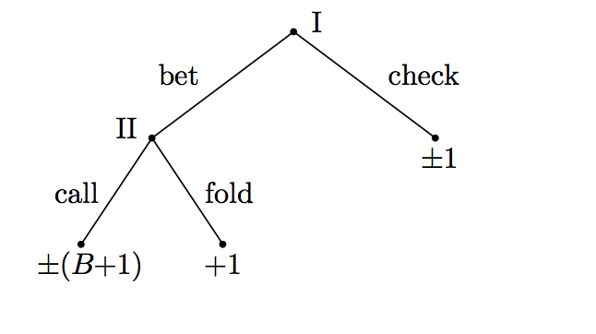
2 Classic Poker Models
Borel’s & von Neumann Model
The two models differ only in what happens if Player I chooses not to bet.
In the Borel model, PI folds: Player I loses one unit to Player II.
In the von Neumann model, PI checks: the hands are compared and the player with the higher hand wins 1 from the opponent.
In the model of Borel, Player I bluffs with the best of the hands he does not bet with. This is the best way to take advantage of mistakes of Player II. There is more money to lose.
In von Neumann’s model Player I bluffs with his worst hands. It is a mistake for him to do otherwise. This is the bluffing strategy commonly used in poker
Tree Diagram of von Neumann’s Game

Slide 5
Poker and Game Theory
Our Focus
We want to understand what is a good strategy in a 2 player Full Texas Holdem game (heads up poker) that may yield the best results.
In doing so we want to compare the results provided by showing the outcome of an aggressive (more bluffs, high risk) playstyle and a passive (rationality of decisions) playstyle making and improving upon decisions made.
Based on Decision Theory and Expected Value Theory, which comes into play, as we are unaware of the incoming cards, and observing other player’s actions (aggressive vs. passive), we will attempt to build an A.I. Poker player.

Slide 6
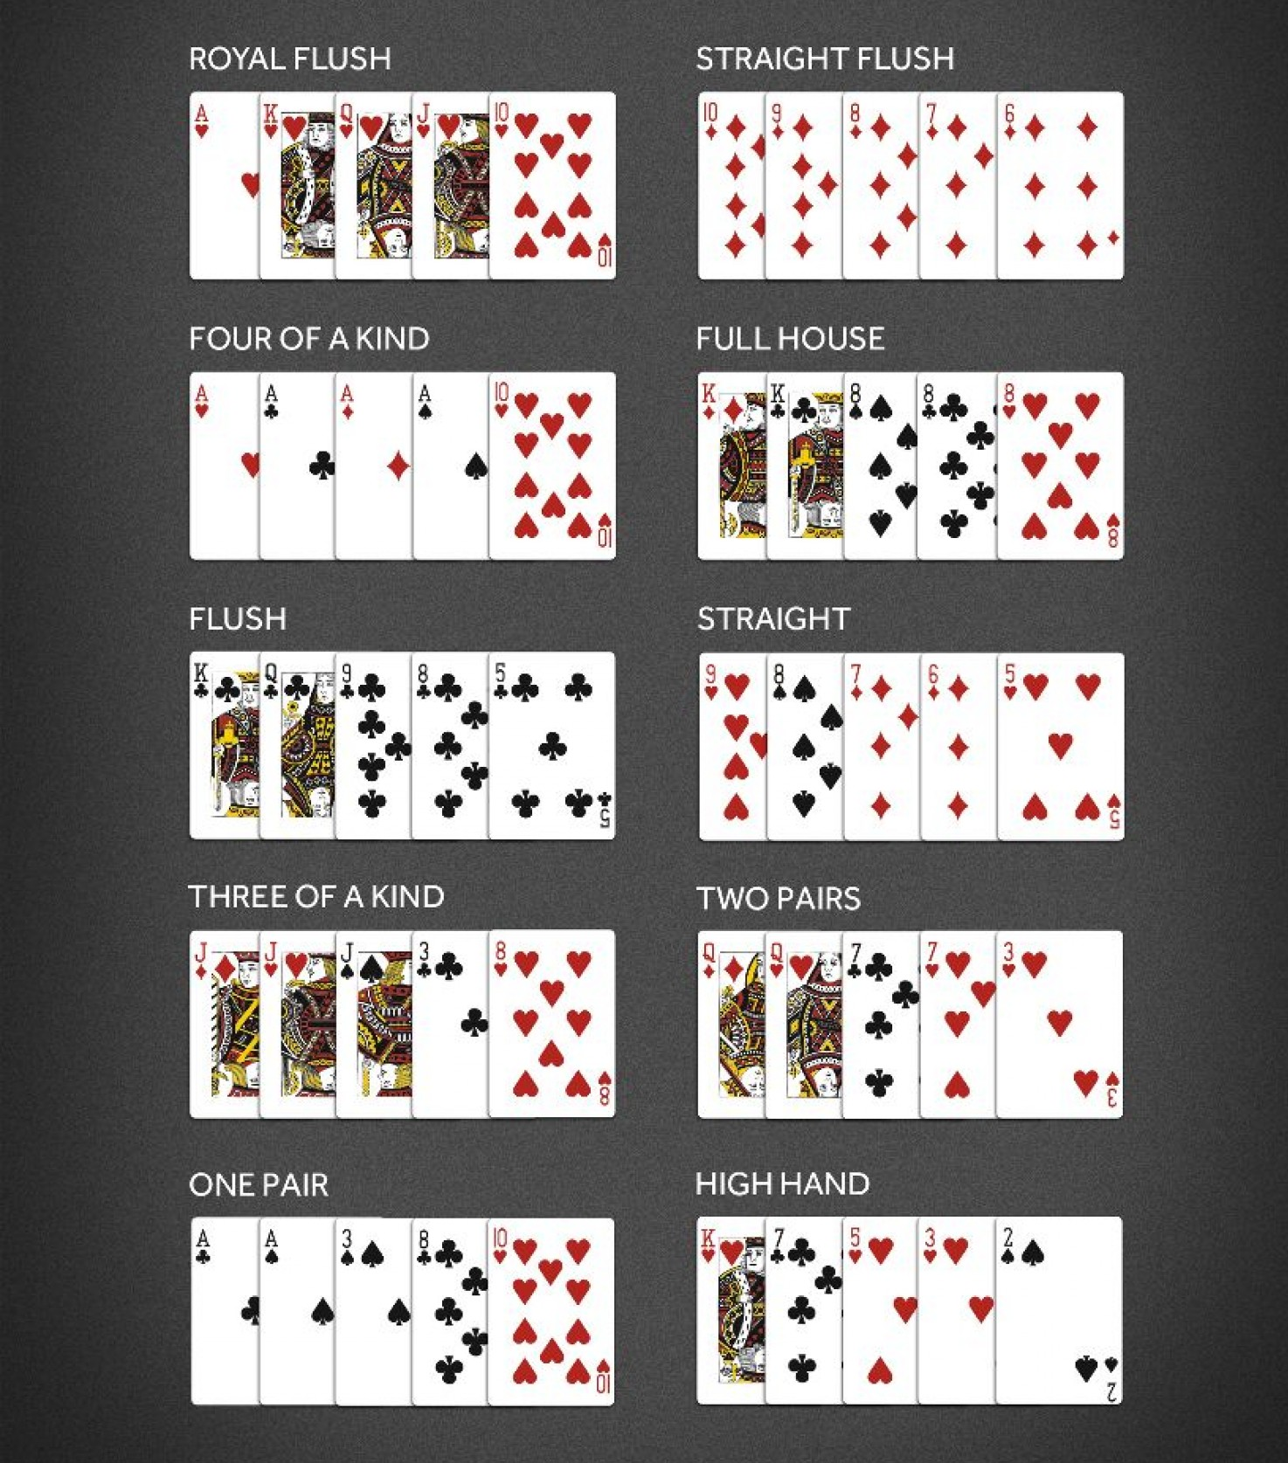
Rules of Heads Up Poker
Type: Texas Holdem
Objective:
Make the best combination of 5 cards possible by
using the players 2 cards + 5 cards placed on board
The ranks of hands are seen on the right. Player with the higher rank
wins the pot.
The game ends when players have played 100 hands, in which case
The player with more chips wins; or when one player has no
remaining chips.

Slide 7
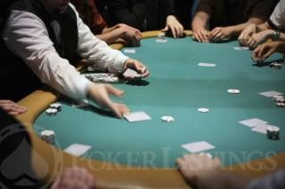
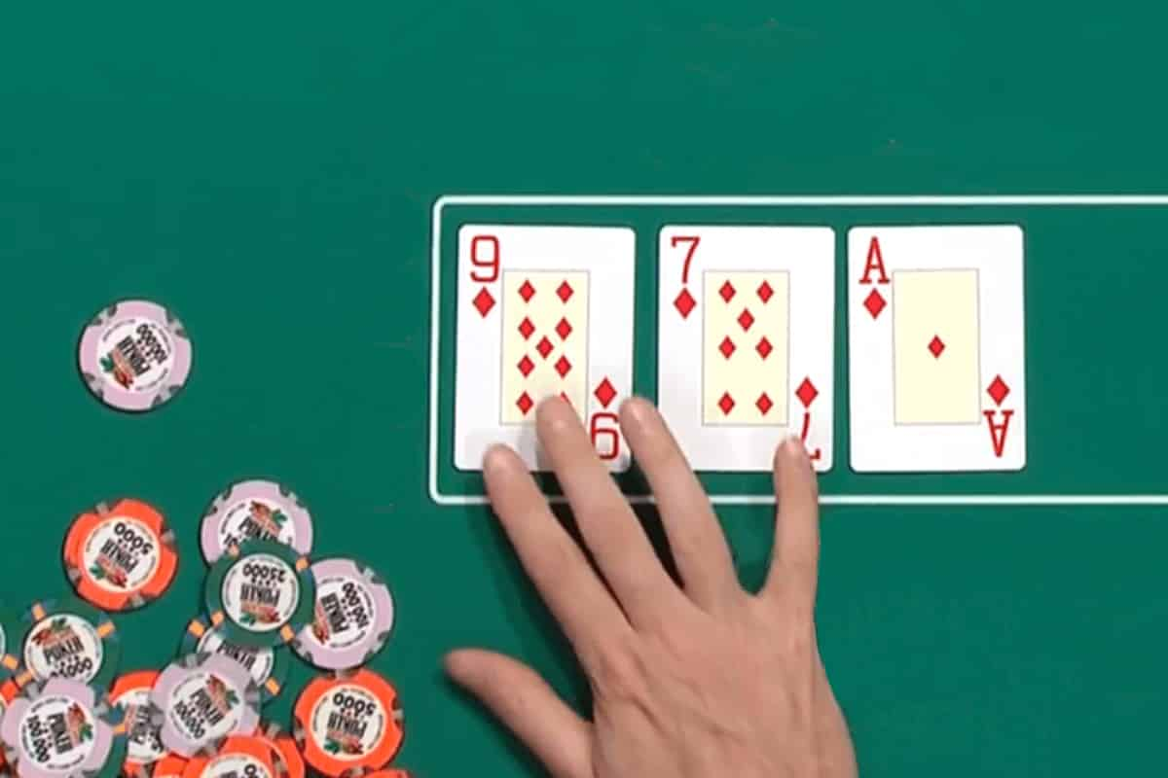
How to play
Game Start
Game starts with 2 forced bets. (Small Blind and Big Blind (2x SB))
Big Blind is the minimum bet necessary to participate in the round.
Once bets are posted, 2 cards are dealt (1 at a time) to each player
Enter Pre-Flop
Players decide whether to play or fold (quit)
Players can call the Big Blind amount or raise the amount bet. (All In’s are acceptable)
Flop
Dealer reveals three cards at the center of the table
Players can use these cards and their cards for combinations
Round of betting begins. Players can call, bet, fold, raise or go all In

Slide 8
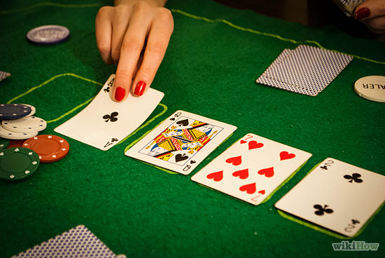
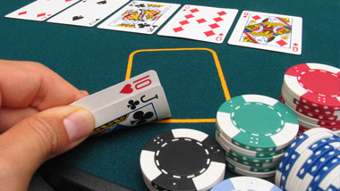
How to play
Turn
Dealer Reveals 4th card
Betting Round Begins
River
Dealer Reveals final card
Final Betting Round takes place
Conclusion
All players reveal their hands and winner is the player whose 5 card combination ranks higher

Slide 9
Common Heads Up Poker Strategies
Aggressive Playstyle
Very important as you’re always betting every hand
Keeps pressure on players
Can backfire, depends on player’s skill
Pot Control
If you have good hand most often you may want to raise
If you have a bad hand manage the pot size to limit loses
Read Opponent
Understand how the other person plays and change strategy accordingly
Hand Power
Hands in heads-up are mostly won by a high card or a pair.
Straights, flushes, full houses happen, but nearly as often as a full table
Any Ace
Most hands will come down to a battle of two unpaired cards

Slide 10
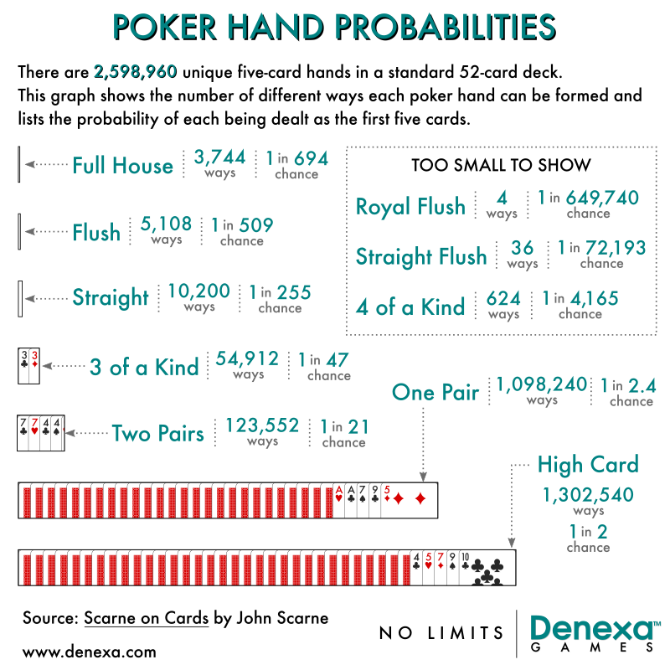
Overview

Slide 11
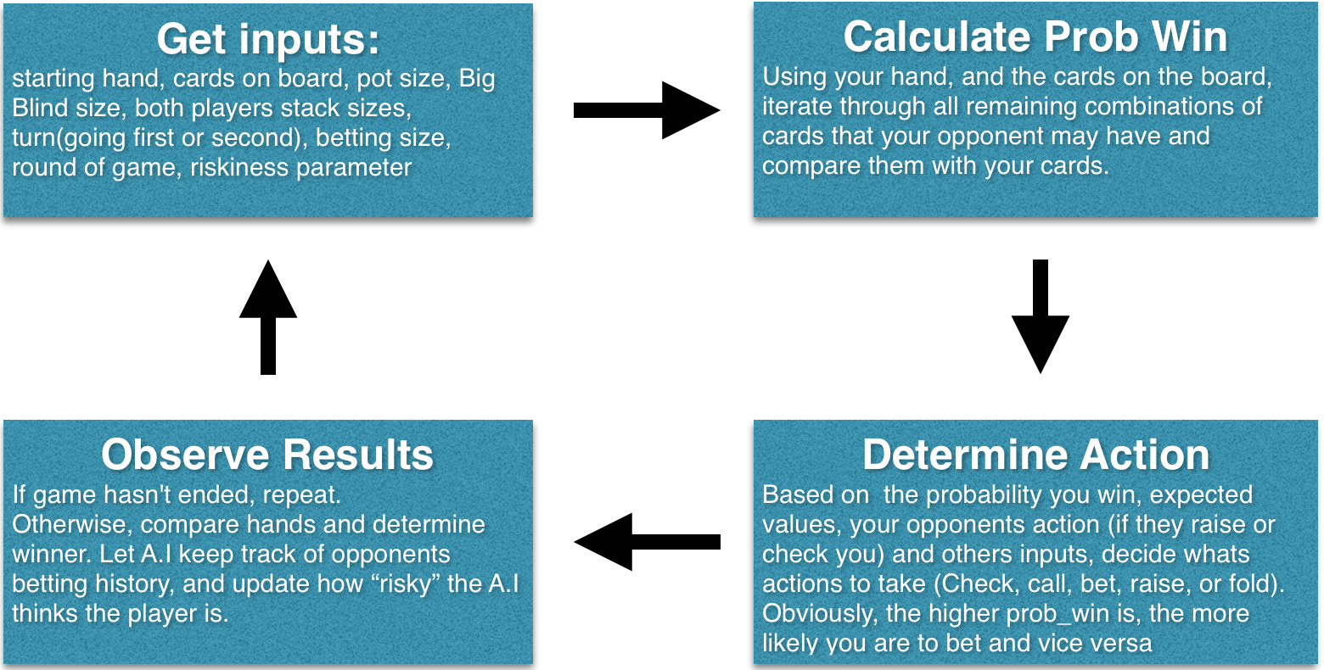
Program / AI flow
In designing a poker A.I, we take advantage of a computer’s ability to make large amounts of fast calculations, and also its ability to “truly” randomize. Below is a flow chart of our poker A.I.s decision making process.

Slide 12
Some Implemented Strategies
Bluffing
Oftentimes you will get a bad hand and the only way to win might be to bluff your opponent. If your opponent also holds a weak hand, and sees a bet from you, your opponent may be reluctant to call and just give up.
2. Value Betting
Value betting occurs when you may think your opponent has a decent and (pair etc), but you have a better hand (three of a kind, flush etc). You can evaluate how much your opponent is willing to pay, and make that bet.
3. Trapping
Every now and then you will come up with a monster hand (pocket aces, full house etc). However, sometimes you can choose to conceal the strength of your hand by making bets and revealing information. Then on the river, you can place a bet (which at this point will seem like a bluff), and trap your opponent into calling you.
4. Shoving
Going all in is a very aggressive poker play, and oftentimes your opponent will put you on a strong hand. When the poker A.I has 10 Big Blinds or less left, it will increase the range of hands it is willing to shove.

Slide 13
Experiment: Game Simulation
52-card full scale
500 chips for each player in the beginning of the game.
Small Blind = 10 chips, Big Blind = 20 chips
“Heads Up” rules
Player moves: call, fold, check and raise(x).
Information of the game flow is open.
Setting is changeable
Interface interacts with AI algorithm.

Slide 14
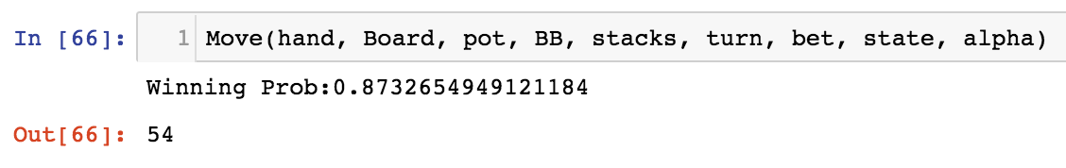
Demo:

Slide 15
Outcome of Project
Comparison results of player playing aggressively and player playing passively
How does a players stack size affect his betting strategies
How should a player behave when he is playing against an aggressive/passive opponent
An interface that simulates the 2-person “heads up” Poker game.
AI Poker player that incorporates game theoretical strategies.
,

